Slide 1
2019-03-14

Slide 2
Logistic Regression Model Training based on the Approximate Homomorphic Encryption
Andrey Kim¹, Yongsoo Song², Miran Kim², Keewoo Lee¹, and Jung Hee Cheon¹
¹ Seoul National University, Seoul, Republic of Korea
² University of California, San Diego, United States

Slide 3
Contents
Abstract (iDASH)
Related Work
Paper Algorithm
Paper Technique
Recent Work

Slide 4
Abstract
We apply the homomorphic encryption scheme of Cheon et al., and devise a new encoding method. In addition, we adapt Nesterov’s accelerated gradient method.
Our method shows a state-of-the-art performance (2017) of homomorphic encryption system in a real-world application.
The submission based on this work was selected as the best solution of Track 3 at iDASH privacy and security competition 2017.

Slide 5
Abstract
iDASH
2017年10月14日，百度安全实验室参加了第7届 iDASH Privacy & Security Workshop，并受邀进行演讲。该 Workshop 是由 UCSD 和 Indiana University 主办，百度、美国国家人类基因研究院（NHGRI）和 Human Longevity 公司赞助。该 Workshop 致力于解决医疗大数据人类基因组分析中的隐私保护问题，并同时举办 iDASH 竞赛，是医疗数据隐私领域的重要学术会议与赛事。学术界享有盛誉的 ACM SIGSAC 副主席 Xiao feng Wang 教授主持了该会议，来自美国国家卫生研究院（NIH）、微软、Intel、IBM以及来自十几个国家的研究员出席了该会议。
微软研究院的Dr. Kristin Lauter做了题为《Cryptographic Tools for Genomic Privacy: Ready for Standardization? 》的演讲，总结了密码学工具在基因组分析隐私保护方向的研究，以及美国在标准化人类基因组分析的隐私保护的努力。Dr. Kristin 认为，基于同态运算的加密和基于 Intel SGX 的加密各有长处，配合使用可以达到保护隐私的效果。

Slide 6
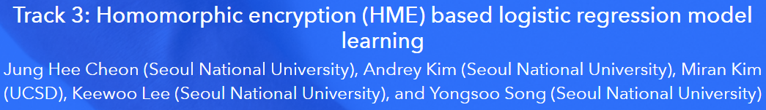
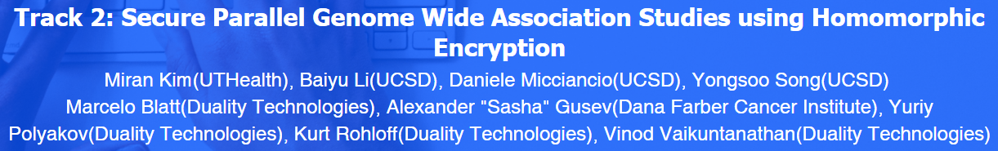
Abstract
2017 Track 3: Homomorphic encryption (HME) based logistic regression model learning.
2018 Track 2: Secure Parallel Genome Wide Association Studies using Homomorphic Encryption.
Competition Winners: Miran Kim, Baiyu Li, Daniele Micciancio, Yongsoo Song

Slide 7
Related Work
Naehrig et al. and Bos et al. both papers assume that the logistic model has already been trained and is publicly available.
Aono et al. they shift the computations that are challenging to perform homomorphically to trusted data sources and a trusted client.
Xie et al. construct PrivLogit which performs logistic regression in a privacy-preserving but distributed manner.
Kim et al.
Secure logistic regression based on homomorphic encryption.

Slide 8
Related Work
2017 iDASH Track 3
Doing Real Work with FHE: The Case of Logistic Regression.
Jack L.H. Crawford, Craig Gentry, Shai Halevi, Daniel Platt, and Victor Shoup.
不像Logistics Regression，使用了复杂的比较操作，可能实用性不强
Logistic regression over encrypted data from fully homomorphic encryption.
Hao Chen, Ran Gilad-Bachrach, Kyoohyung Han, Zhicong Huang, Amir Jalali, Kim Laine, and
Kristin Lauter. 参考了首尔国立大学密码实验室的方案
Logistic Regression Model Training based on the Approximate Homomorphic Encryption.
Andrey Kim, Yongsoo Song, Miran Kim, Keewoo Lee, and Jung Hee Cheon.
Privacy-Preserving Logistic Regression Training.
Charlotte Bonte, and Frederik Vercauteren. 近期工作
2018 iDASH Track 2

Slide 9
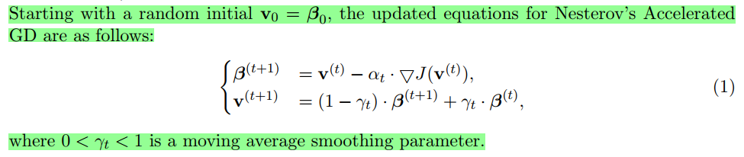

Logistic Regression
Gradient Descent
初始化权重向量$W$
for i = $1$ : $MAX_ITER$ do
% compute the gradient $g$
$W=W − α∙g$
Nesterov’s accelerated gradient method

Slide 10
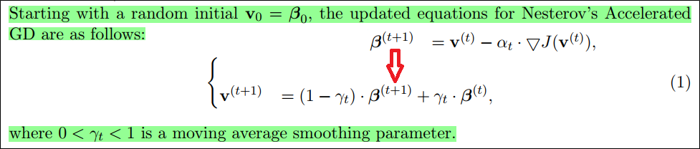
Logistic Regression
Gradient Descent
初始化权重向量$W$
for i = $1$ : $MAX_ITER$ do
% compute the gradient $g$
$W=W − α∙g$
Nesterov’s accelerated gradient method

Slide 11

Logistic Regression
Gradient Descent
初始化权重向量$W$
for i = $1$ : $MAX_ITER$ do
% compute the gradient $g$ 初始化数据至区间[-1,+1] 使得 Sigmoid函数的输入值较小
$W=W − α∙g$
Nesterov’s accelerated gradient method

Slide 12
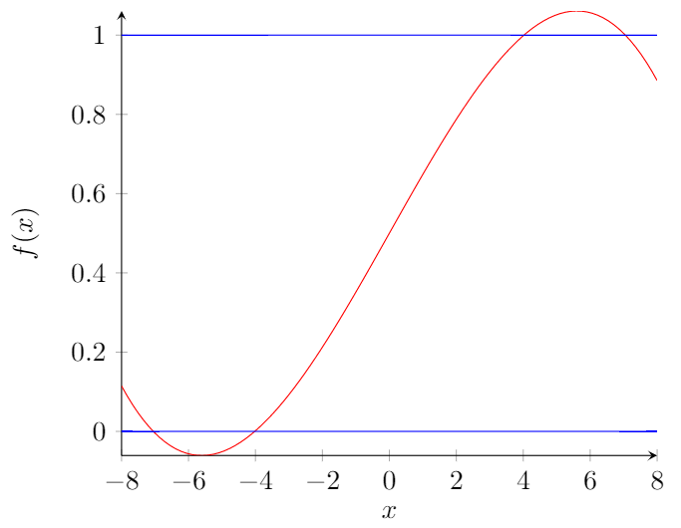
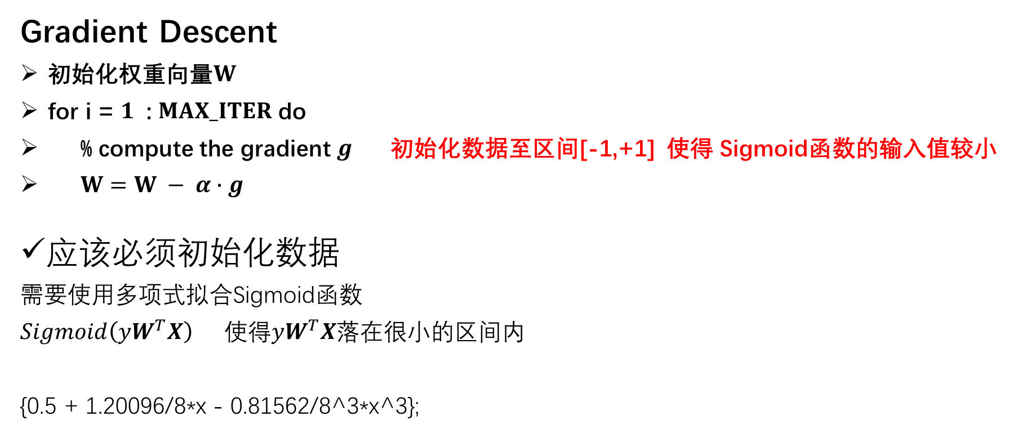
Paper Technique
Gradient Descent
初始化权重向量$W$
for i = $1$ : $MAX_ITER$ do
% compute the gradient $g$ 初始化数据至区间[-1,+1] 使得 Sigmoid函数的输入值较小
$W=W − α∙g$
应该必须初始化数据
需要使用多项式拟合Sigmoid函数
$Sigmoid\left(yW^{T}X\right)$ 使得$yW^{T}X$落在很小的区间内
{0.5 + 1.20096/8*x - 0.81562/8^3*x^3};

Slide 13
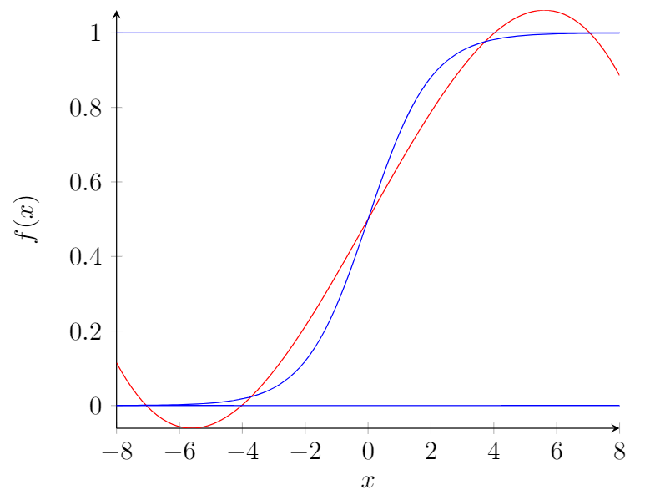
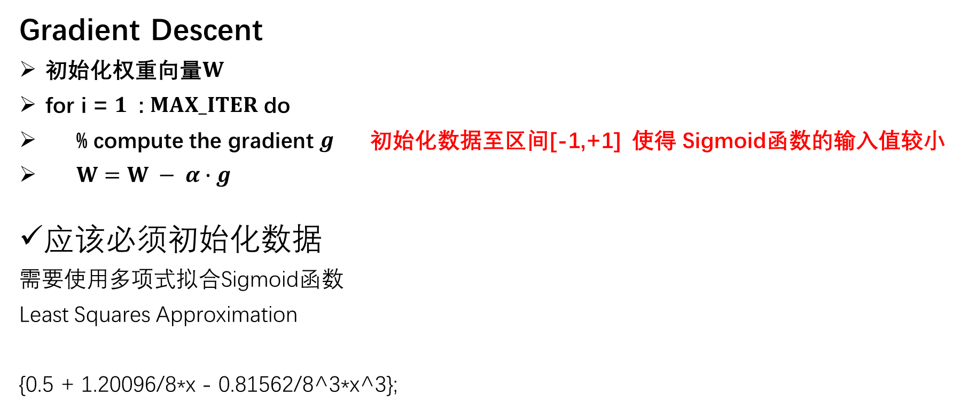
Paper Technique
Gradient Descent
初始化权重向量$W$
for i = $1$ : $MAX_ITER$ do
% compute the gradient $g$ 初始化数据至区间[-1,+1] 使得 Sigmoid函数的输入值较小
$W=W − α∙g$
应该必须初始化数据
需要使用多项式拟合Sigmoid函数
Least Squares Approximation
{0.5 + 1.20096/8*x - 0.81562/8^3*x^3};

Slide 14
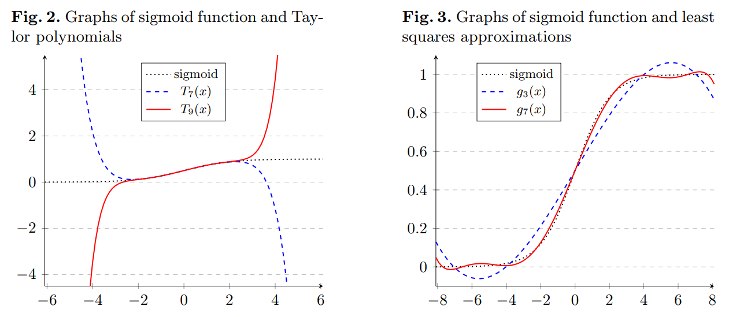
Paper Technique
Gradient Descent
初始化权重向量$W$
for i = $1$ : $MAX_ITER$ do
% compute the gradient $g$ 初始化数据至区间[-1,+1] 使得 Sigmoid函数的输入值较小
$W=W − α∙g$
应该必须初始化数据
需要使用多项式拟合Sigmoid函数
Least Squares Approximation
{0.5 + 1.20096/8*x - 0.81562/8^3*x^3};

Slide 15
Paper Technique
Homomorphic Encryption Scheme: HEAAN
他们自己设计的同态加密库
同态加密的计算时间大 密文由系数为大整数的超长维数的向量构成
在应用到实际中，编码问题也会严重影响计算量
The main idea is to treat an encryption noise as part of error occurring during approximate computations.
We still have a problem that the bit size of message increases exponentially with the depth of a circuit without rounding.
We suggest a new technique – called rescaling – that manipulates the message of ciphertext.

Slide 16
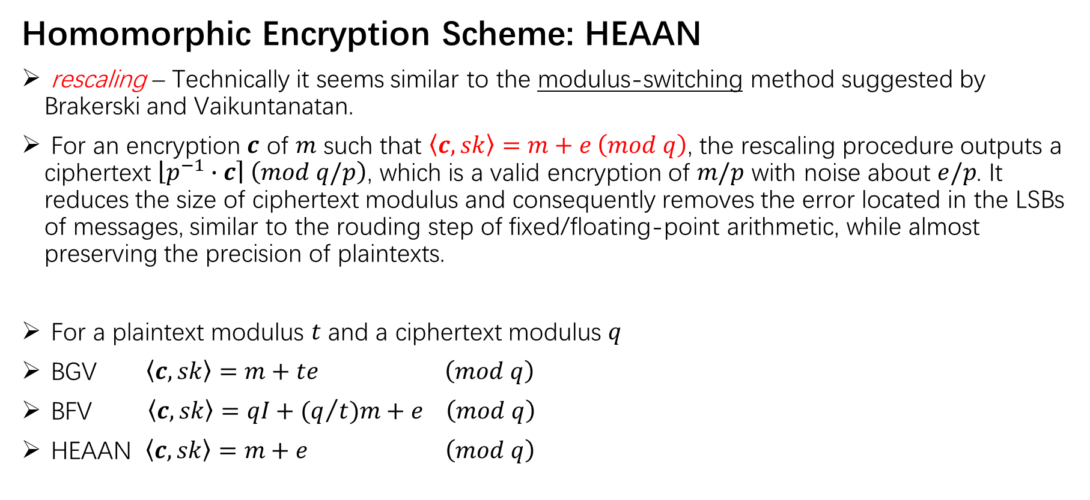
Paper Technique
Homomorphic Encryption Scheme: HEAAN
rescaling – Technically it seems similar to the modulus-switching method suggested by Brakerski and Vaikuntanatan.
For an encryption $c$ of $m$ such that $\left\langle c, sk\right\rangle =m+e \left(mod q\right)$, the rescaling procedure outputs a ciphertext $\left\lfloor \left.p^{−1}∙c\right\rceil \right. \left(mod q/p\right)$, which is a valid encryption of $m/p$ with noise about $e/p$. It reduces the size of ciphertext modulus and consequently removes the error located in the LSBs of messages, similar to the rouding step of fixed/floating-point arithmetic, while almost preserving the precision of plaintexts.
For a plaintext modulus $t$ and a ciphertext modulus $q$
BGV $\left\langle c, sk\right\rangle =m+te \left(mod q\right)$
BFV $\left\langle c, sk\right\rangle =qI+(q/t)m+e \left(mod q\right)$
HEAAN $\left\langle c, sk\right\rangle =m+e \left(mod q\right)$

Slide 17
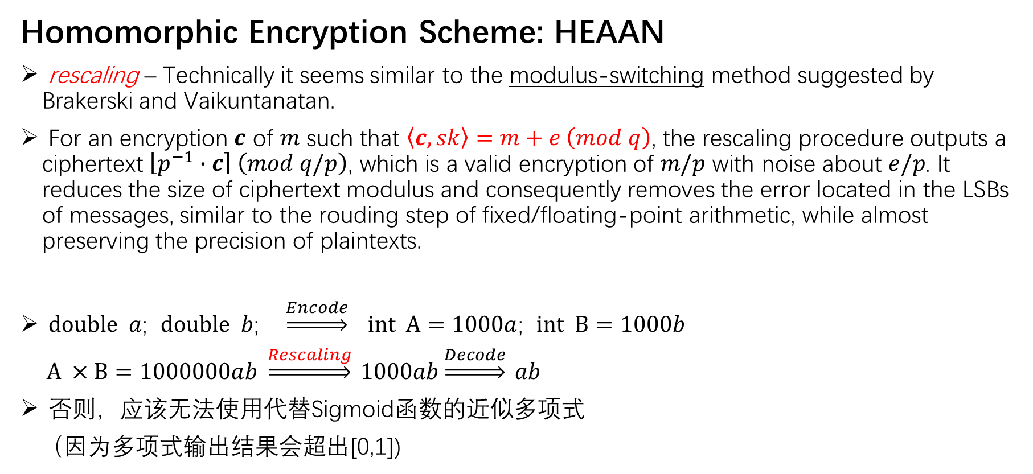
Paper Technique
Homomorphic Encryption Scheme: HEAAN
rescaling – Technically it seems similar to the modulus-switching method suggested by Brakerski and Vaikuntanatan.
For an encryption $c$ of $m$ such that $\left\langle c, sk\right\rangle =m+e \left(mod q\right)$, the rescaling procedure outputs a ciphertext $\left\lfloor \left.p^{−1}∙c\right\rceil \right. \left(mod q/p\right)$, which is a valid encryption of $m/p$ with noise about $e/p$. It reduces the size of ciphertext modulus and consequently removes the error located in the LSBs of messages, similar to the rouding step of fixed/floating-point arithmetic, while almost preserving the precision of plaintexts.
$double a$; $double b$; $\underset{⇒}{Encode}$ $int A=1000a$; $int B=1000b$
$A ×B=1000000ab \underset{⇒}{Rescaling} 1000ab\underset{⇒}{Decode} ab$
否则，应该无法使用代替Sigmoid函数的近似多项式
（因为多项式输出结果会超出[0,1])

Slide 18
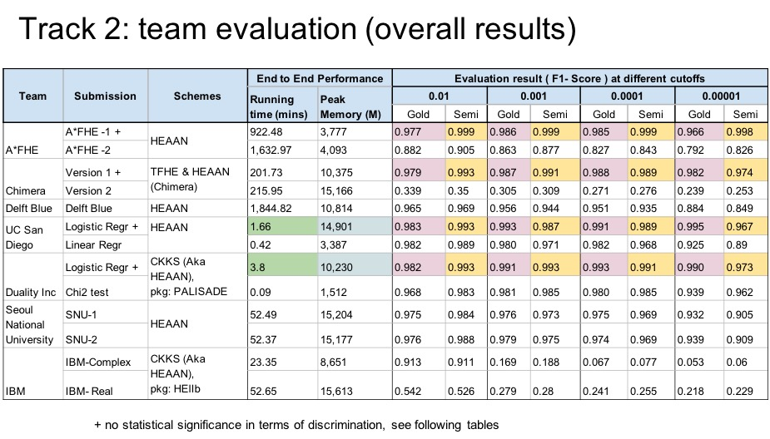
Paper Technique
https://yongsoosong.github.io/images/idash18_track2.jpg

Slide 19
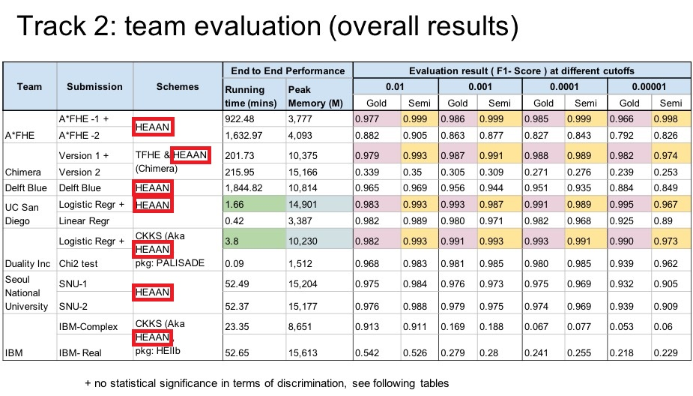
Paper Technique
https://yongsoosong.github.io/images/idash18_track2.jpg

Slide 20
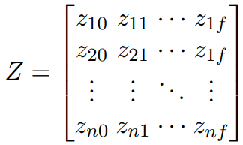
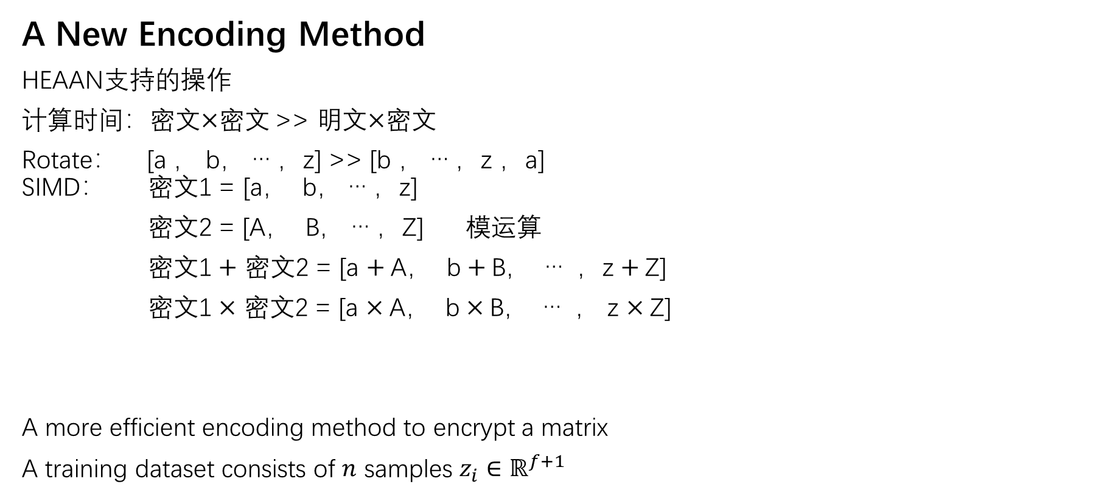
Paper Technique
A New Encoding Method
HEAAN支持的操作
计算时间：密文$×$密文 >> 明文$×$密文
Rotate： [a ， b， … ，z] >> [b ， … ，z ，a] SIMD： 密文1 = [a， b， … ，z]
密文2 = [A， B， … ，Z] 模运算
密文1 $+$ 密文2 = [a $+$A， b $+$B， … ，z $+$Z]
密文1 $×$ 密文2 = [a $×$A， b $×$B， … ， z $×$Z]
A more efficient encoding method to encrypt a matrix
A training dataset consists of $n$ samples $z_{i}∈ℝ^{f+1}$

Slide 21
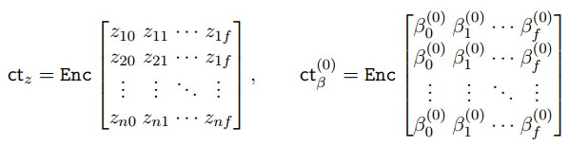
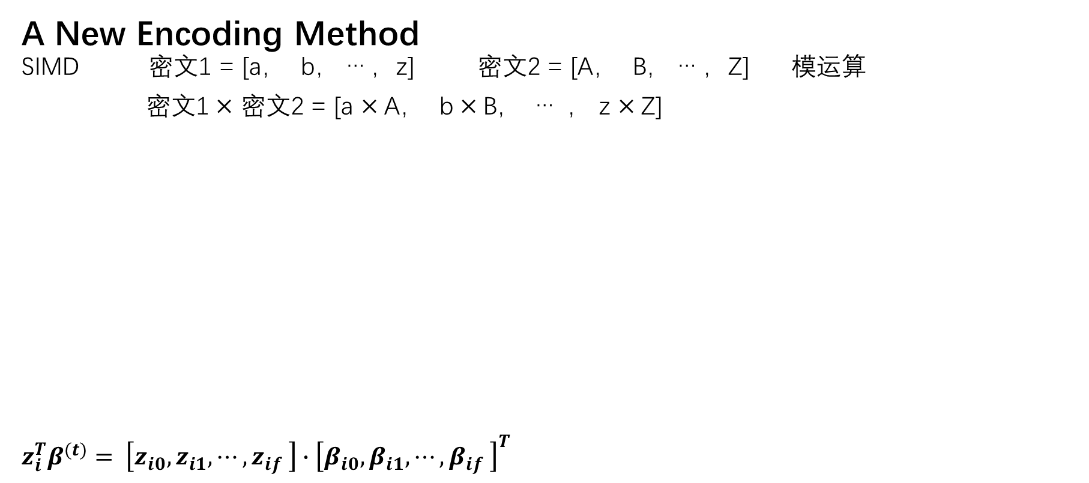
Paper Technique
A New Encoding Method SIMD 密文1 = [a， b， … ，z] 密文2 = [A， B， … ，Z] 模运算
密文1 $×$ 密文2 = [a $×$A， b $×$B， … ， z $×$Z]
$$z_{i}^{T}β^{(t)}= \left[z_{i0},z_{i1}, ⋯, z_{if} \right]∙{\left[β_{i0},β_{i1}, ⋯, β_{if} \right]}^{T}$$

Slide 22
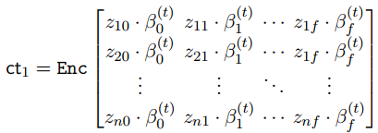
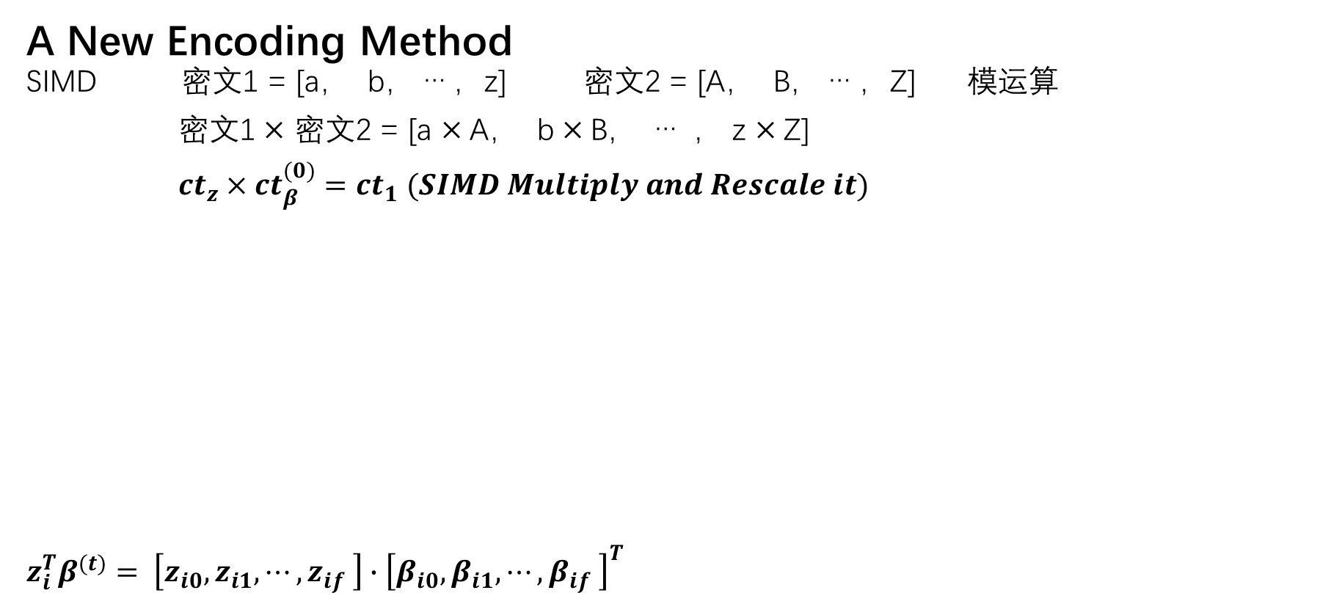
Paper Technique
A New Encoding Method SIMD 密文1 = [a， b， … ，z] 密文2 = [A， B， … ，Z] 模运算
密文1 $×$ 密文2 = [a $×$A， b $×$B， … ， z $×$Z]
${ct}_{z}×{ct}_{β}^{(0)}={ct}_{1} (SIMD Multiply and Rescale it)$
$$z_{i}^{T}β^{(t)}= \left[z_{i0},z_{i1}, ⋯, z_{if} \right]∙{\left[β_{i0},β_{i1}, ⋯, β_{if} \right]}^{T}$$

Slide 23
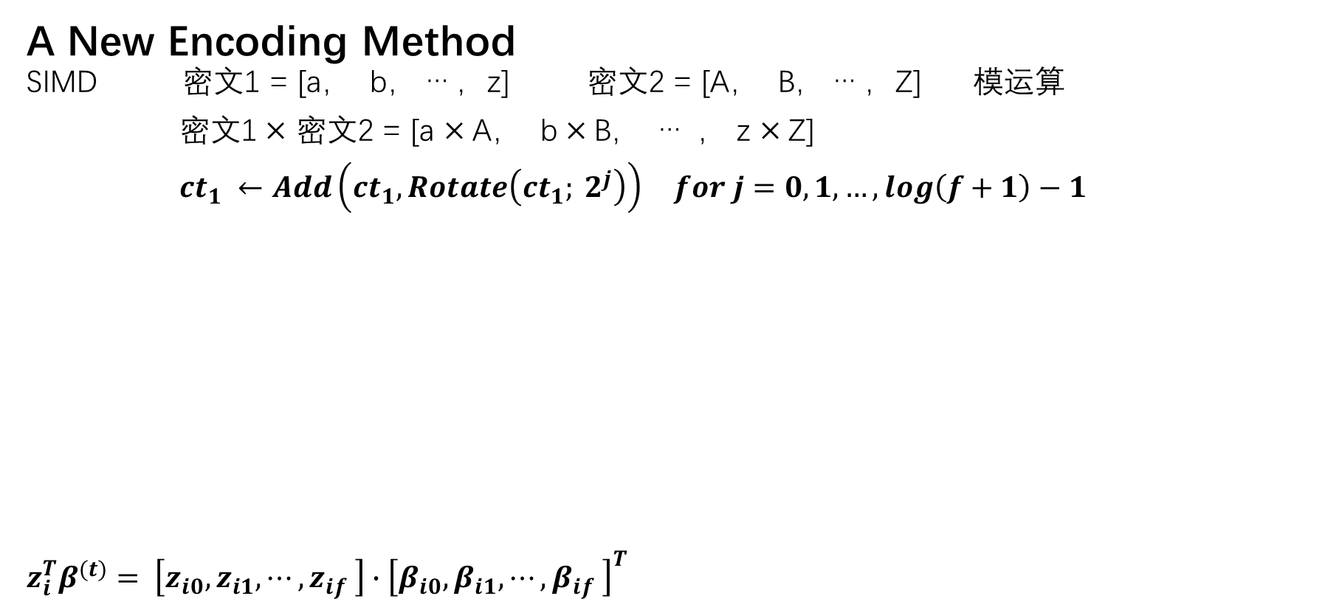
Paper Technique
A New Encoding Method SIMD 密文1 = [a， b， … ，z] 密文2 = [A， B， … ，Z] 模运算
密文1 $×$ 密文2 = [a $×$A， b $×$B， … ， z $×$Z]
${ct}_{1} ←Add\left({ct}_{1}, Rotate\left({ct}_{1}; 2^{j}\right)\right) for j=0,1,…,log\left(f+1\right)−1$
$$z_{i}^{T}β^{(t)}= \left[z_{i0},z_{i1}, ⋯, z_{if} \right]∙{\left[β_{i0},β_{i1}, ⋯, β_{if} \right]}^{T}$$

Slide 24
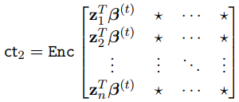
Paper Technique
A New Encoding Method SIMD 密文1 = [a， b， … ，z] 密文2 = [A， B， … ，Z] 模运算
密文1 $×$ 密文2 = [a $×$A， b $×$B， … ， z $×$Z]
${ct}_{1} ←Add\left({ct}_{1}, Rotate\left({ct}_{1}; 2^{j}\right)\right) for j=0,1,…,log\left(f+1\right)−1$
$$z_{i}^{T}β^{(t)}= \left[z_{i0},z_{i1}, ⋯, z_{if} \right]∙{\left[β_{i0},β_{i1}, ⋯, β_{if} \right]}^{T}$$

Slide 25
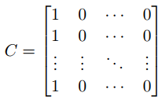
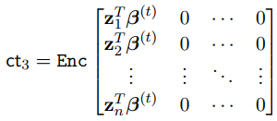
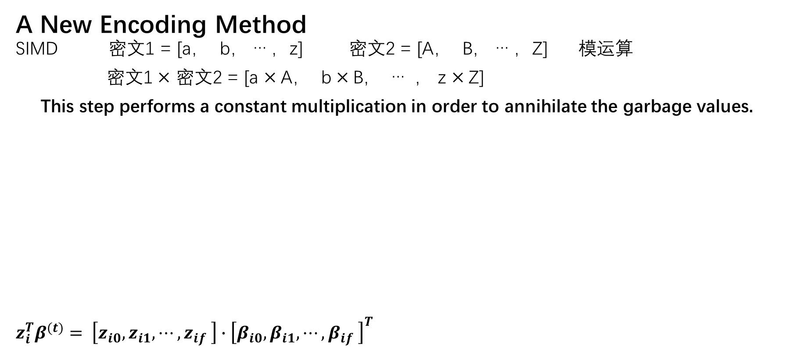
Paper Technique
A New Encoding Method SIMD 密文1 = [a， b， … ，z] 密文2 = [A， B， … ，Z] 模运算
密文1 $×$ 密文2 = [a $×$A， b $×$B， … ， z $×$Z]
This step performs a constant multiplication in order to annihilate the garbage values.
$$z_{i}^{T}β^{(t)}= \left[z_{i0},z_{i1}, ⋯, z_{if} \right]∙{\left[β_{i0},β_{i1}, ⋯, β_{if} \right]}^{T}$$

Slide 26
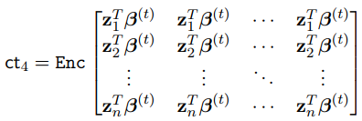
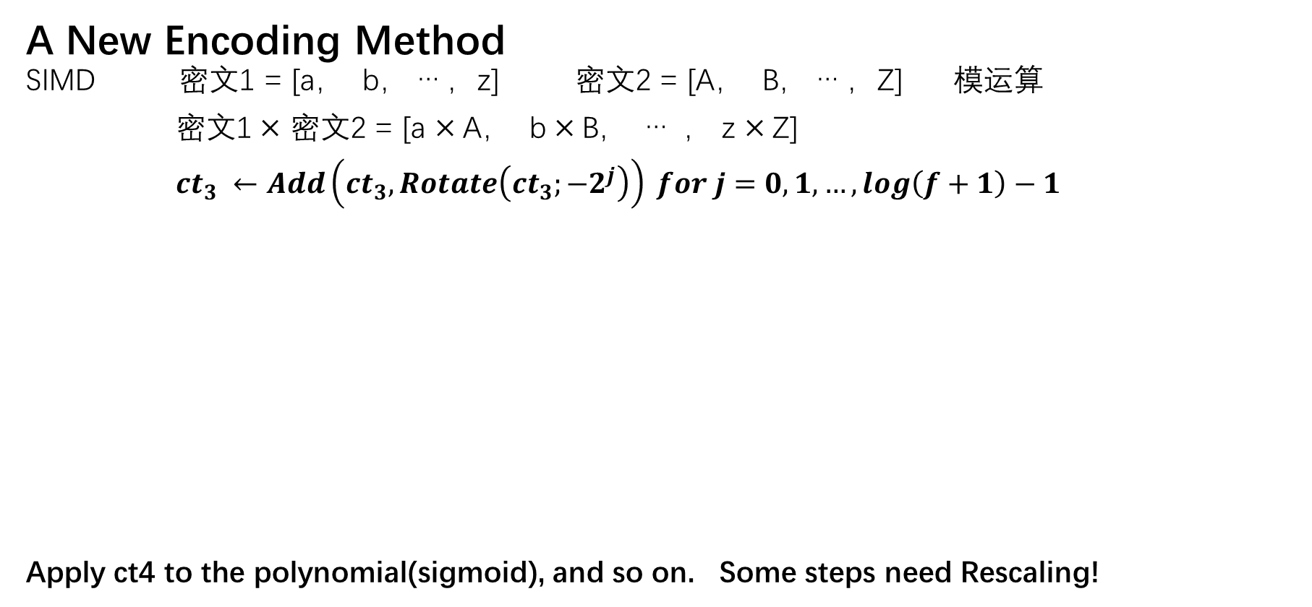
Paper Technique
A New Encoding Method SIMD 密文1 = [a， b， … ，z] 密文2 = [A， B， … ，Z] 模运算
密文1 $×$ 密文2 = [a $×$A， b $×$B， … ， z $×$Z]
${ct}_{3} ←Add\left({ct}_{3}, Rotate\left({ct}_{3};−2^{j}\right)\right) for j=0,1,…,log\left(f+1\right)−1$
Apply ct4 to the polynomial(sigmoid), and so on. Some steps need Rescaling!

Slide 27
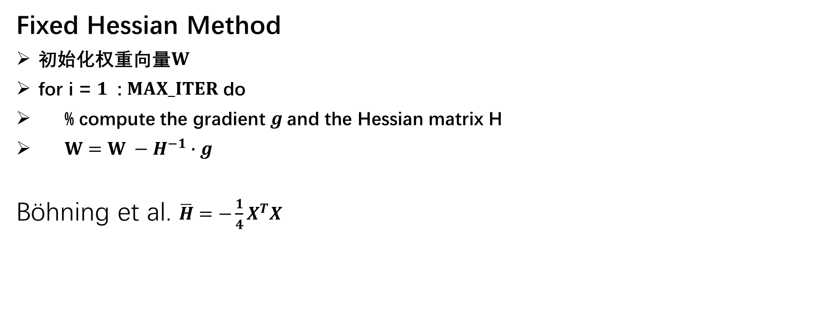
Recent Work
Fixed Hessian Method
初始化权重向量$W$
for i = $1$ : $MAX_ITER$ do
% compute the gradient $g$and the Hessian matrix H
$W=W −H^{−1}∙g$
Böhning et al. $\overline{H}=−\frac{1}{4}X^{T}X$

Slide 28
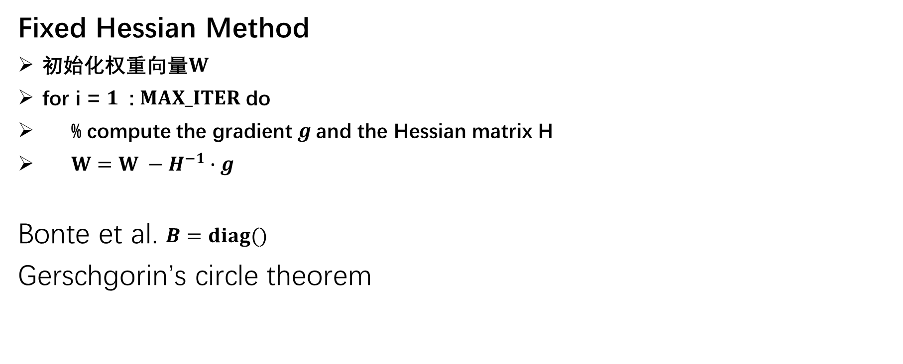
Recent Work
Fixed Hessian Method
初始化权重向量$W$
for i = $1$ : $MAX_ITER$ do
% compute the gradient $g$and the Hessian matrix H
$W=W −H^{−1}∙g$
Bonte et al. $B=diag()$
Gerschgorin’s circle theorem

Slide 29
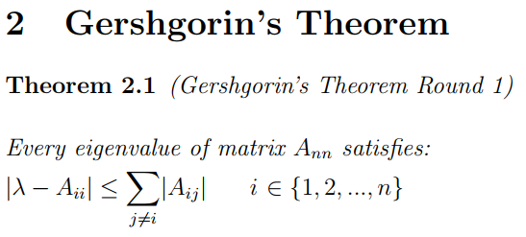
Recent Work
Gerschgorin’s circle theorem

Slide 30
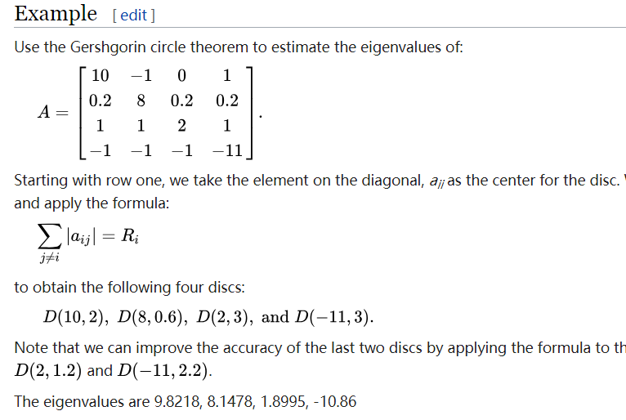

Recent Work
$$\left|λ−10\right|≤\left|−1\right|+\left|0\right|+\left|1\right|$$
$$\left|λ−10\right|≤\left|0.2\right|+\left|1\right|+\left|−1\right|$$
>>
$$\left|λ−10\right|≤2$$
$$\left|λ−10\right|≤2.2$$
>>
$$D\left(10, 2\right)$$
>>
$$8≤λ≤12$$

